Slide 1


Alvis Sze
26 June 2022

Slide 2

Outline
Executive Summary
Introduction
Methodology
Results
Conclusion
Appendix

Slide 3
Executive Summary
Summary of methodologies
Data Collection via API and Web Scraping
Data Wrangling
Exploratory Data Analysis with SQL and Data Visualization
Interactive Visual Analytics with Folium
Machine Learning Prediction
Summary of all results
Exploratory Data Analysis result
Interactive analytics result
Predictive Analytics result

Slide 4
Introduction
Project background and context
We predicted if the Falcon 9 first stage will land successfully. SpaceX advertises Falcon 9 rocket launches on its website, with a cost of 62 million dollars; other providers cost upward of 165 million dollars each, much of the savings is because SpaceX can reuse the first stage. Therefore if we can determine if the first stage will land, we can determine the cost of a launch. This information can be used if an alternate company wants to bid against SpaceX for a rocket launch.
Problems you want to find answers
What will influence if the rocket will land successfully>
What is the relationship among different variables which will affect the success rate of a successful landing?
What conditions does SpaceX have to be in place to ensure a successful landing?

Slide 5

Section 1

Slide 6
Methodology
Executive Summary
Data collection methodology:
Data collected via SpaceX API and Web scrapping from Wikipedia
Perform data wrangling
One-hot encoding for Machine Learning and data clearning
Perform exploratory data analysis (EDA) using visualization and SQL
Perform interactive visual analytics using Folium and Plotly Dash
Perform predictive analysis using classification models

Slide 7
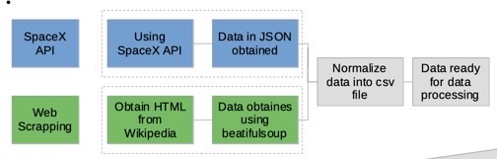
Data Collection
Describe how data sets were collected.
- Using Space X API to obtain launch data. (Data collection)
- Obtain data about rocket launches and using JSON to normalize the data.
- Cleaning data prior data processing.
- Another way to collect data is Web scrapping using BeautifulSoup from Wikipedia.
- The data obtained using BeautifulSoup then normalize for data processing.

Slide 8
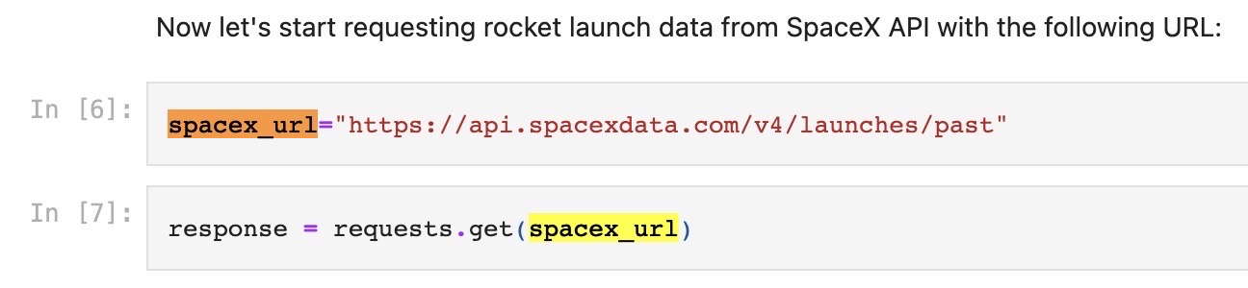
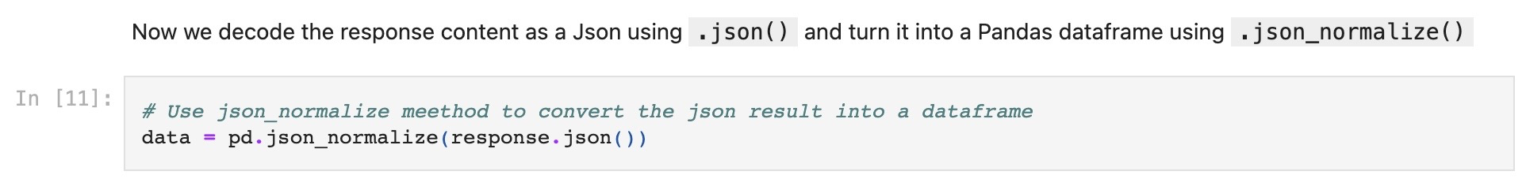
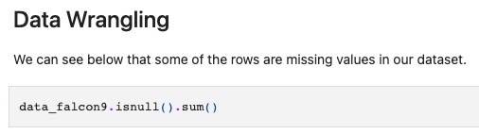
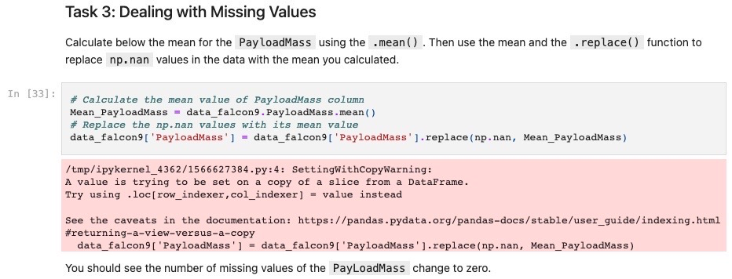
Data Collection – SpaceX API
Obtain rocket launch data from Space X API from URL
Normalising data using JSON
Filtering the dataframe to only include related data
Data Wrangling
Dealing with Missing vlaues
https://github.com/alvissze/IBM-project/blob/main/jupyter-labs-spacex-data-collection-api.ipynb
Exporting to a CSV file

Slide 9
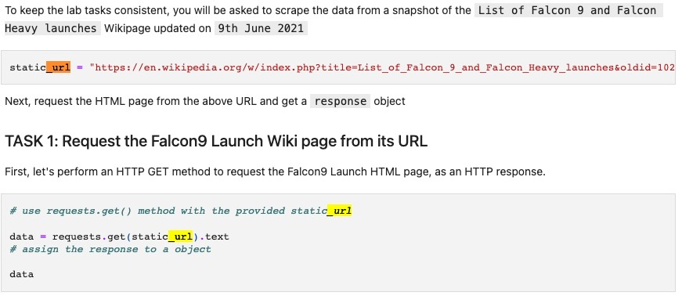
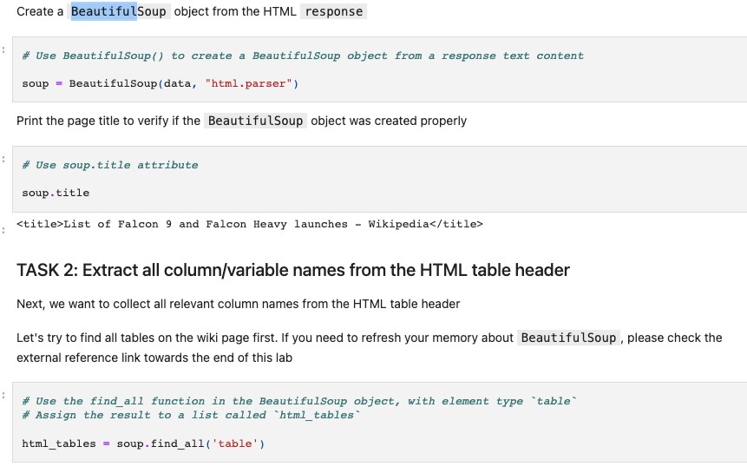
Data Collection - Scraping
HTTP Get for launch page
Webscrap launch records using BeautifulSoup
Webscrap launch records using BeautifulSoup
Webscrap launch records using BeautifulSoup
Converting data into pandas dataframe
Converting data into pandas dataframe
Exporting data to CSV file
Exporting data to CSV file
https://github.com/alvissze/IBM-project/blob/main/jupyter-labs-webscraping.ipynb

Slide 10

Data Wrangling
We perform some Exploratory Data Analysis (EDA) to find some patterns in the data and determine what would be the label for training supervised models.
In the data set, there are several different cases where the booster did not land successfully. Sometimes a landing was attempted but failed due to an accident; for example, True Ocean means the mission outcome was successfully landed to a specific region of the ocean while False Ocean means the mission outcome was unsuccessfully landed to a specific region of the ocean. True RTLS means the mission outcome was successfully landed to a ground pad False RTLS means the mission outcome was unsuccessfully landed to a ground pad.True ASDS means the mission outcome was successfully landed on a drone ship False ASDS means the mission outcome was unsuccessfully landed on a drone ship.
In this lab we mainly convert those outcomes into Training Labels with 1 means the booster successfully landed 0 means it was unsuccessful.
Perform Exploratory Data Analysis
Calculate the number of launches at each site
Calculate the number and occurence of each orbit
https://github.com/alvissze/IBM-project/blob/main/labs-jupyter-spacex-Data%20wrangling.ipynb
Calculate the number and occurence of mission outcome per orbit type
Calculate a landing outcome label from Outcome column
Export to CSV
Determine the success rate

Slide 11
EDA with Data Visualization
Three type of graphs used for data visualization.
Scatter Graphs:
A scatter plot is a type of data visualization that shows the relationship between different variables. This data is shown by placing various data points between an x- and y-axis. It is to determine if there are patterns or correlations between two variables.
- Fight Number vs. Payload Mass
- Flight Number vs. Launch Site
- Payload vs. Launch Site
- Flight Number vs. Orbit type
- Payload vs. Orbit Type
https://github.com/alvissze/IBM-project/blob/main/jupyter-labs-eda-dataviz.ipynb
Bar chart:
Bar chart is the chart that use one unit to describe a fixed value, then draw rectangular bars of corresponding length proportion based on values, and finally sequence them with an order. This chart presents the value of each category intuitively and visually for making a comparison of different categories.
- Success rate vs. Class of each Orbit
Line chart:
A line chart is a type of chart used to show information that changes over time. Line charts are created by plotting a series of several points and connecting them with a straight line. Line charts are used to track changes over short and long periods.
- Success Rate vs. Year

Slide 12
EDA with SQL
Performed SQL queries to gather information about the dataset. Using SQL queries to get the answers in the dataset :
- Display the names of the unique launch sites in the space mission
- Display 5 records where launch sites begin with the string 'CCA'
- Display the total payload mass carried by boosters launched by NASA (CRS)
- Display average payload mass carried by booster version F9 v1.1
- List the date when the first successful landing outcome in ground pad was acheived.
- List the names of the boosters which have success in drone ship and have payload mass greater than 4000 but less than 6000
- List the total number of successful and failure mission outcomes
- List the names of the booster_versions which have carried the maximum payload mass. Use a subquery
- List the failed landing_outcomes in drone ship, their booster versions, and launch site names for in year 2015
- Rank the count of landing outcomes (such as Failure (drone ship) or Success (ground pad)) between the date 2010-06-04 and 2017-03-20, in descending order
https://github.com/alvissze/IBM-project/blob/main/SQL.ipynb

Slide 13
Build an Interactive Map with Folium
Summarize what map objects such as markers, circles, lines, etc. you created and added to a folium map
Explain why you added those objects
We mark all launch sites on a map, mark the success/failed launches for each site on the map and calculate the distances between a launch site to its proximities
To visualize the Launch Data into an interactive map. We used the Latitude and Longitude Coordinates at each launch site and added a Circle Marker around each launch site with a label of the name of the launch site.
We classify the dataframe launch_outcomes(failures, successes) to classes 0 and 1 with Green and Red markers on the map using MarkerCluster()
Example of some trends in which the Launch Site is situated in.
•Are launch sites in close proximity to railways? No
•Are launch sites in close proximity to highways? No
•Are launch sites in close proximity to coastline? Yes
•Do launch sites keep certain distance away from cities? Yes
https://github.com/alvissze/IBM-project/blob/main/lab_jupyter_launch_site_location.ipynb

Slide 14
Build a Dashboard with Plotly Dash
Summarize what plots/graphs and interactions you have added to a dashboard
We built an interactive dashboard using Plotly dash
We plotted pie charts showing the total launches by a certain sites
We plotted scatter graph showing the relationship between Outcome and Payload Mass (Kg) for the different booster version.
https://github.com/alvissze/IBM-project/blob/main/spacex_dash_app.py

Slide 15
Predictive Analysis (Classification)
We load the data using pandas and numpy, transform the data, split the data into training and testing data sets.
Set out the parameters and algorithms using GridSearchCV.
Check the accuracy for each model and plot confusion matrix. The model with the best accuracy score wins the best performing model.
https://github.com/alvissze/IBM-project/blob/main/SpaceX_Machine%20Learning%20Prediction_Part_5.ipynb

Slide 16
Results
Exploratory data analysis results
Interactive analytics demo in screenshots
Predictive analysis results

Slide 17

Section 2

Slide 18
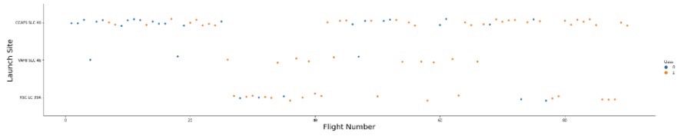
Flight Number vs. Launch Site
According to the plot, the larger flight number at the launch site, the greater success rate.

Slide 19
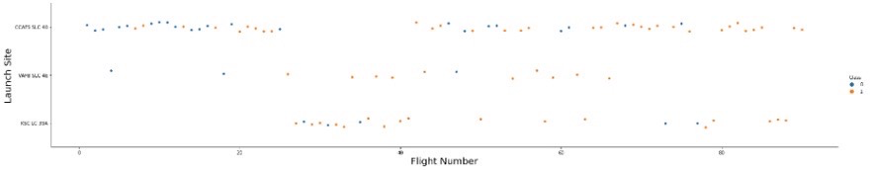
Payload vs. Launch Site
The greater the payload mass for Launch Site CCAFS SLC 40, the higher the success rate for the rocket. For the VAFB-SLC launch site there are no rockets launched for heavy payload mass(greater than 10000)

Slide 20
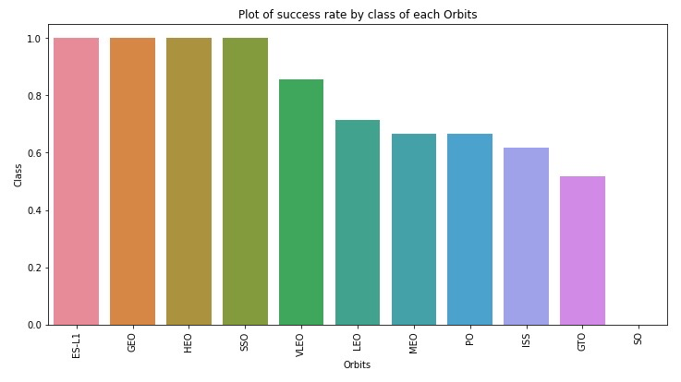
Success Rate vs. Orbit Type
From the plot, Orbit ES-L1 GEO,HEO,SSO, has the best Success Rate

Slide 21
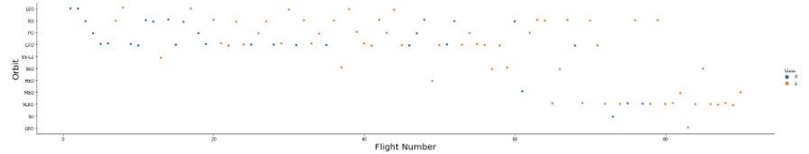
Flight Number vs. Orbit Type
From the plot, it shows that in the LEO orbit, success rate is related to the number of flights. In the GTO orbit, there is no relationship between the flight number and the orbit type.

Slide 22
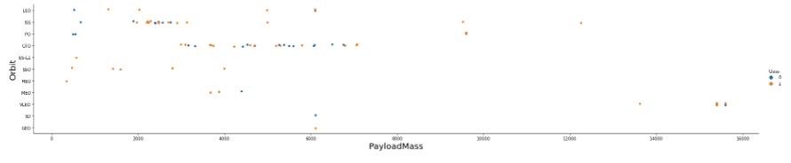
Payload vs. Orbit Type
We can observe that with heavy payloads, the successful landing are more for PO, LEO and ISS orbits.

Slide 23
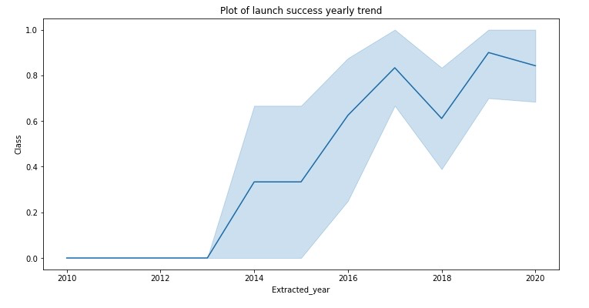
Launch Success Yearly Trend
From the line chart, we can observe that the launch success rate keep raising from 2013 till 2020.

Slide 24
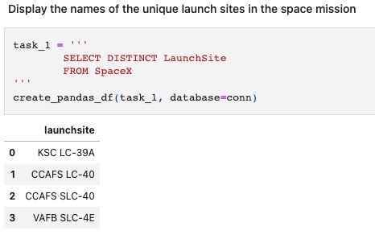
All Launch Site Names
From the query, we can find the the names of the unique launch sites.
There are four launch site,s KAC LC-39A, CCAFS LC-40, CCAFS SLC-40 and VAFB SLC-4E.

Slide 25
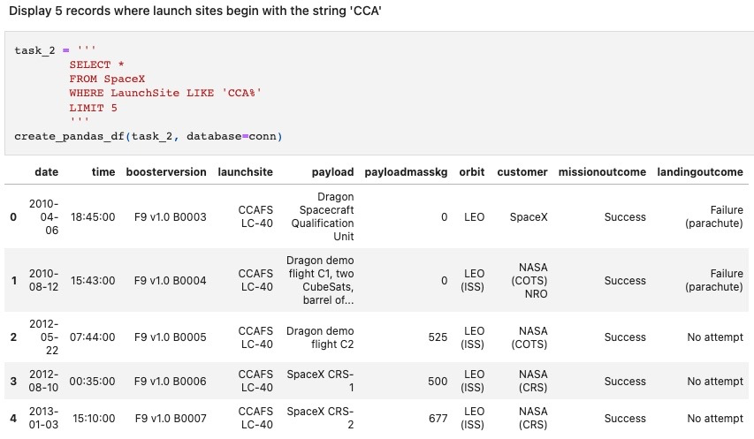
Launch Site Names Begin with 'CCA'
From the query result, we can find information about the launch sites begin with `CCA`. For example, date of launch, payload, orbit, customer, the outcome of mission, landing outcome and etc.

Slide 26
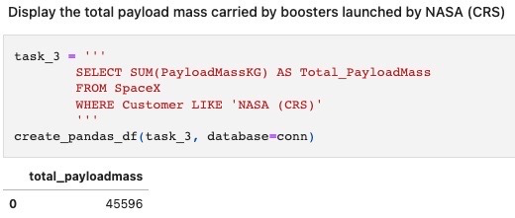
Total Payload Mass
After calculation, the total payload carried by boosters from NASA is 45,596.

Slide 27
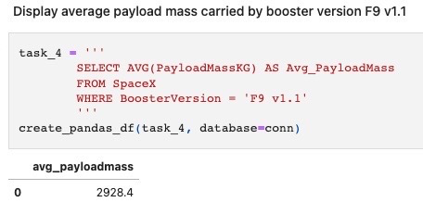
Average Payload Mass by F9 v1.1
After calculation, the average payload mass carried by booster version F9 v1.1 is 2,928.4.

Slide 28
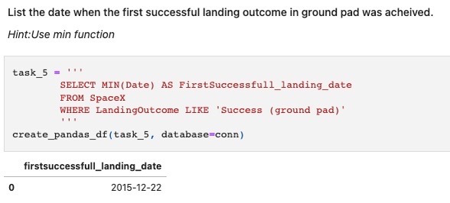
First Successful Ground Landing Date
From the query, we can find the dates of the first successful landing outcome on ground pad is 2015/12/22.

Slide 29
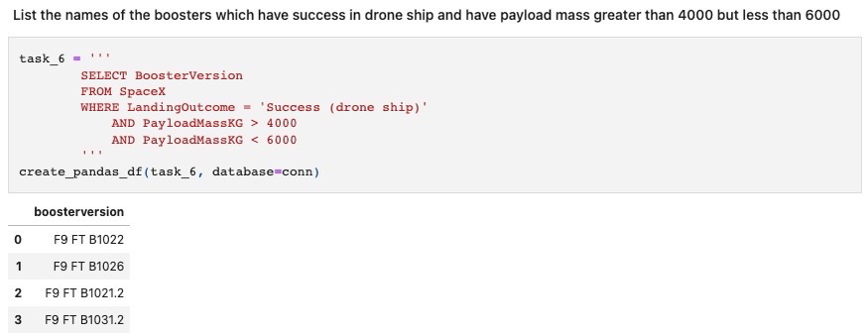
Successful Drone Ship Landing with Payload between 4000 and 6000
From the query, there are four boosters which have successfully landed on drone ship and had payload mass greater than 4000 but less than 6000. The four boosters are F9 FT B1022, F9 FT B1026, F9 FT B1021.2 and F9 FT B1031.2.

Slide 30
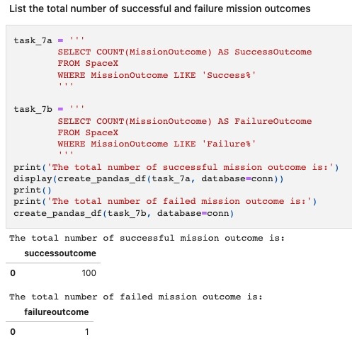
Total Number of Successful and Failure Mission Outcomes
From the query, the total number of successful and failure mission outcomes are 100 and 1 respectively.

Slide 31
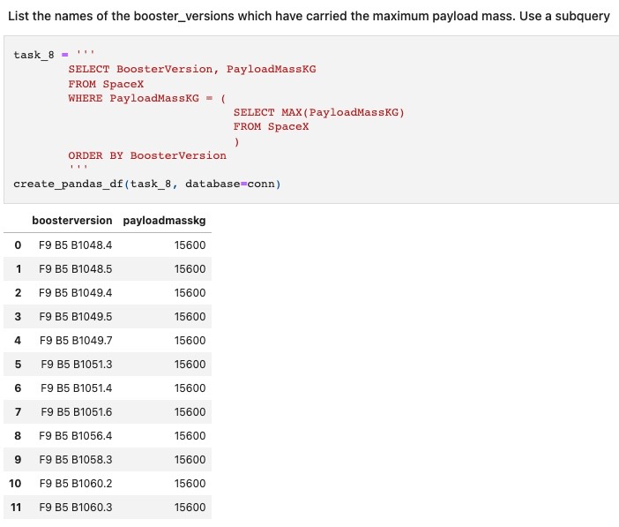
Boosters Carried Maximum Payload
From the query, we can find the names of the booster which have carried the maximum payload mass.
From the list, it includes F9 B5 B1048.4, F9 B5 B1048.5, F9 B5 B1049.4, F9 B5 B1049.5, F9 B5 B1049.5 and etc.

Slide 32
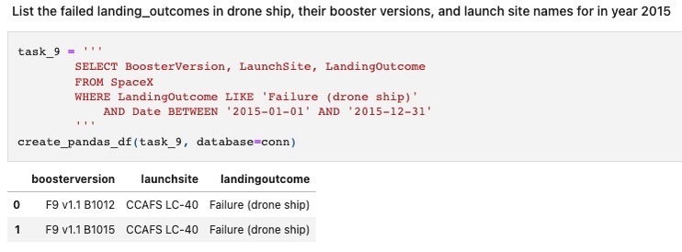
2015 Launch Records
From the query, we can observe the failed landing_outcomes in drone ship, their booster versions, and launch site names for in year 2015.
The booster version are F9 v1.1 B1012, F9 v1.1 B1015 and both the launch site is CCAFS LC-40.

Slide 33
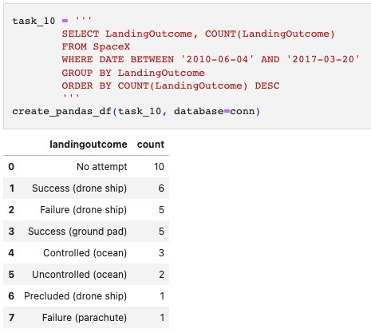
Rank Landing Outcomes Between 2010-06-04 and 2017-03-20
From the ranking of the count of landing outcomes (such as Failure (drone ship) or Success (ground pad)) between the date 2010-06-04 and 2017-03-20, in descending order, we can observe that the highest number of landing outcome is no attempt and followed by success (drone ship).

Slide 34

Section 3

Slide 35
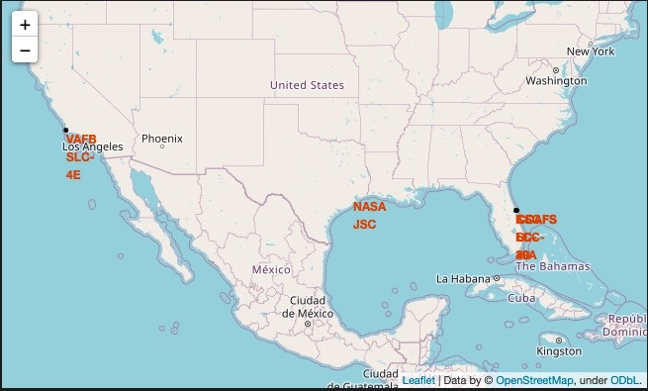
Rocket launch sites with markers
Three launch sites have been found using the Folium with markers. Three Space X launch sites are Houston, Florida and Los Angeles.

Slide 36
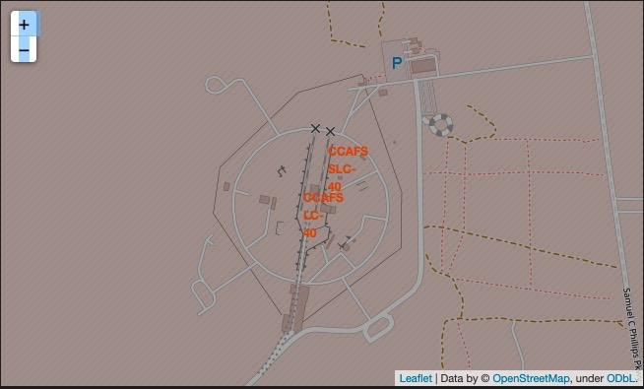
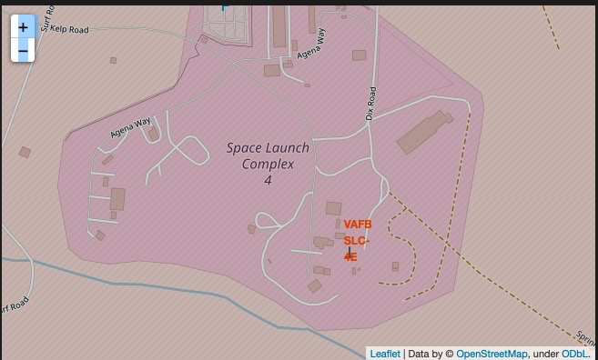
Launch sites with color markers
Not successful showing the color-labeled launch outcomes on the map.

Slide 37
Launch site showing distance
Not successful showing the color-labeled launch outcomes on the map.

Slide 38

Section 4

Slide 39
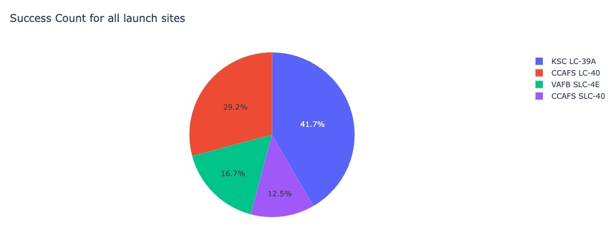
Pie chart showing the launch success count for all launch sites
Show the screenshot of launch success count for all sites, in a piechart.
Including KSC LC-39 A, CCAFS LC-40, VAFB SLC-4E and CCAFS SLC-40. KSC LC-30A has the highest success count with 41.7% while the lowest success count is 12.5% in CCAFS SLC-40.

Slide 40
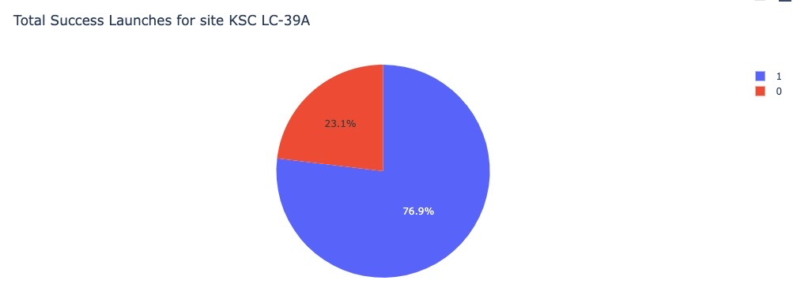
Pie chart for the launch site with highest launch success ratio
Replace <Dashboard screenshot 2> title with an appropriate title
Show the screenshot of the piechart for the launch site with highest launch success ratio. KSC LC-39A with 76.0% success launch while 23.1% failure rate.

Slide 41
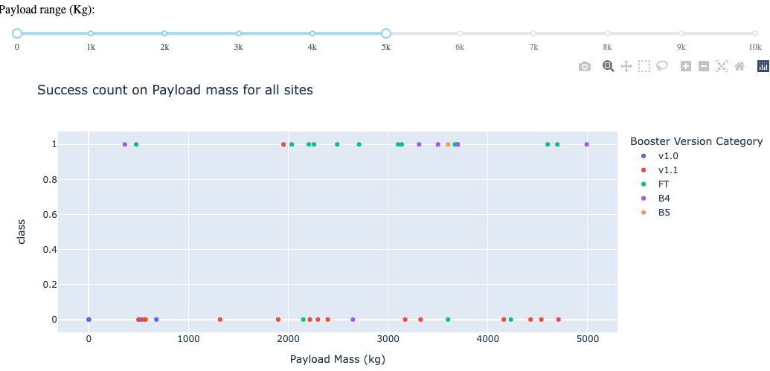
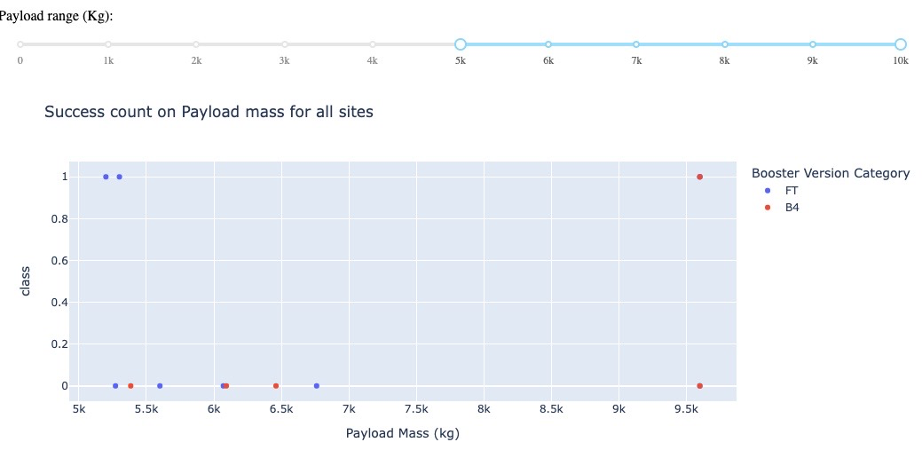
Scatter plot of Payload mass vs launch outcome for different site
Two plot on the right show Payload vs. Launch Outcome scatter plot for all sites, with different payload selected in the range slider.
0 – 5000 kg on the upper right, which shows that the success count is higher than 5000-10000kg.
From the upper right, it is obvious that the v.10 booster version has the largest success rate.

Slide 42

Section 5

Slide 43
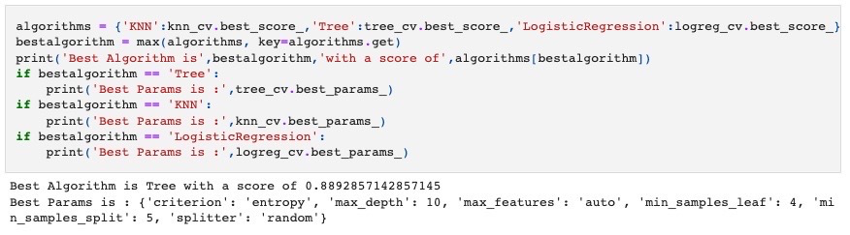
Classification Accuracy
The highest accuracy of the model is Decision tree.
Even though, the result is not visualized.
However, the Best Algorithm is Tree with a score of 0.89.

Slide 44

Confusion Matrix
The confusion matrix on the right shows that there is no false negative. True negative and false positive are both 3. And true positive is the highest with the number 12.
However the problem of this confusion matrix is that there is 3 false positive which means failed landing but marked as successful landing.

Slide 45
Conclusions
The following points are the conclusion of this project.
1. KSC LC-39A shows the most successful launches for all the launch sites.
2. Lower weighted payloads (<5000kg) achieve successful landing than higher weighted payloads.
3. We can observe that the launch success rate keep raising from 2013 till 2020.
4. Orbit ES-L1 GEO,HEO,SSO, has the best Success Rate.

Slide 46
Appendix
Include any relevant assets like Python code snippets, SQL queries, charts, Notebook outputs, or data sets that you may have created during this project

Slide 47


